Slide 1
Introduction to Machine Learning and Deep Leaning

Slide 2
Before Machine Learning

Slide 3
Models, models, models “experimental data”
We build models all the time. What are the models ?
Why models are important ?
What do models give us as scientists and engineers ?

Slide 4






Need to select the capacity of the circuit breaker.

Slide 5
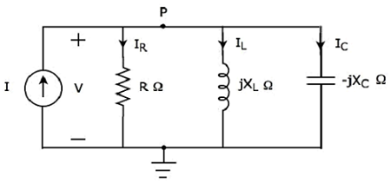
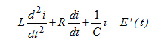
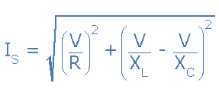
The classical approach
Step 2: Build the electric model.
Step 3: find The mathematical model and use it.

Slide 6
But Sometimes Modelling with fundamental laws is really hard.
Because:
Maybe we don’t have enough “Science”.
The phenomena under study is really complicated, and very stochastic in nature. “ consider economic, social, biological, and climate phenomena”.

Slide 7
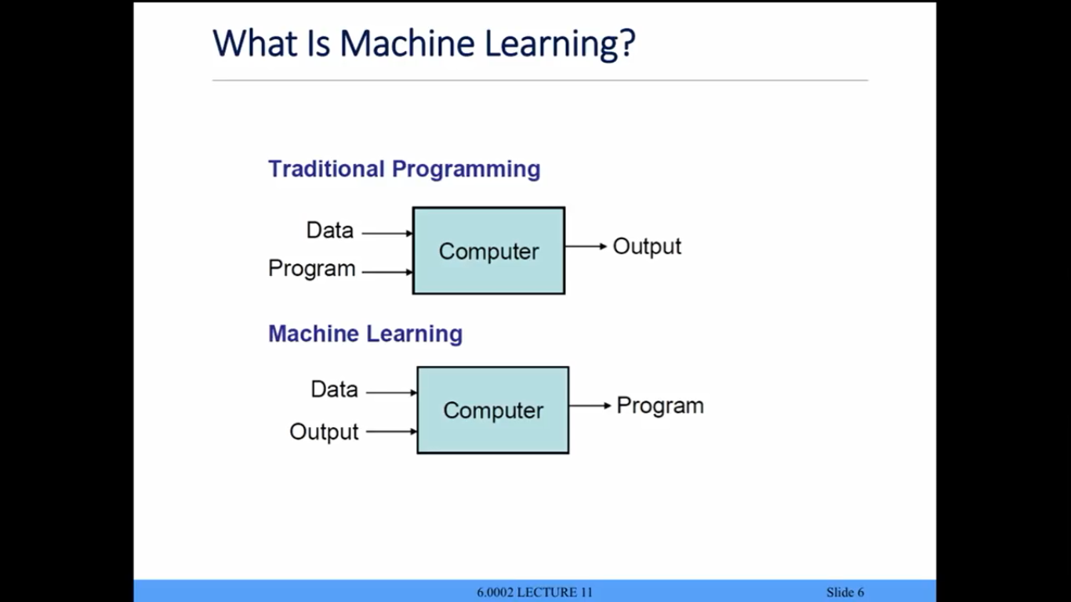
What is Machine Learning ?
Traditional programming vs Machine learning.

Slide 8
How would ML solve the previous problem ?

Slide 9
The main steps of Machine Learning
Objective definition.
Learn Mapping from x -> y directly.
Model selection.
Feature extraction.
Optimization.
Using the model.

Slide 10
Optimization
Features
Model
Output
Loss

Slide 11
The Concept of Parametrized Model
parameter
parameter
parameter
Model

Slide 12
Steps:
You need to have X and the True Y:
Start with initial model (random parameters).
Feed X into the model , and Compute predicted Y.
Compare predicted Y to True Y.
From the result of the comparison “modify” the model such that the next time you feed X into the model, the result will be more similar to True Y.

Slide 13
Optimization
x
Model
Y
Compare
Y to Y

Slide 14
What are the features? Why are they important ?
Back to modelling ? How do we get features ?

Slide 15
Deep Learning
Optimization
Features
Model
Output
Loss

Slide 16

Machine Learning learns based on correlation. Correlation ≠ Causation Pigeon superstition

Slide 17
Case study: Snake Classification

Slide 18
The most Important take away
All models are WRONG but some are USEFUL.
Garbage in Garbage out !

